Slide 1


INSY7315 · WORK INTEGRATED LEARNING · EXPO 2026
Verteco SmartJob
Replacing paper-based job cards with one connected web & mobile platform — from job creation to signed-off completion.
Team Vantage · Group 20
22 October 2026

Slide 2




THE CLIENT
VERTECO
About Verteco
A South African power & infrastructure company — and who we built SmartJob for.
Industry
What They Do
Company Profile
Vision
Power, renewable energy, telecommunications & IT infrastructure.
Solar, battery, generator & hybrid-energy systems, plus data-centre, telecom & steel-enclosure builds.
Founded 2013 in South Africa · ~50 staff, ~25 engineers · Level 1 B-BBEE, woman-empowered.
To be a leading provider of quality energy and innovative infrastructure solutions.
VERTECO SMARTJOB · TEAM VANTAGE
1

Slide 3






MEET THE TEAM
VERTECO
Team Vantage — Group 20
Six specialists, one connected platform.
Moegammad Alexander
Caleb Forbes
Alexandro Ornelas
Group Leader · Project Manager & Data Lead
Web Front-End Lead
Backend Core Lead
ST10453511
ST10438433
ST10437348
Erin Sarjoo
Keeran Perumal
Isaac Phiri
Mobile Lead
Security & Identity Lead
DevOps, Hosting & API Platform Lead
ST10450571
ST10367702
ST10074970
VERTECO SMARTJOB · TEAM VANTAGE
2

Slide 4
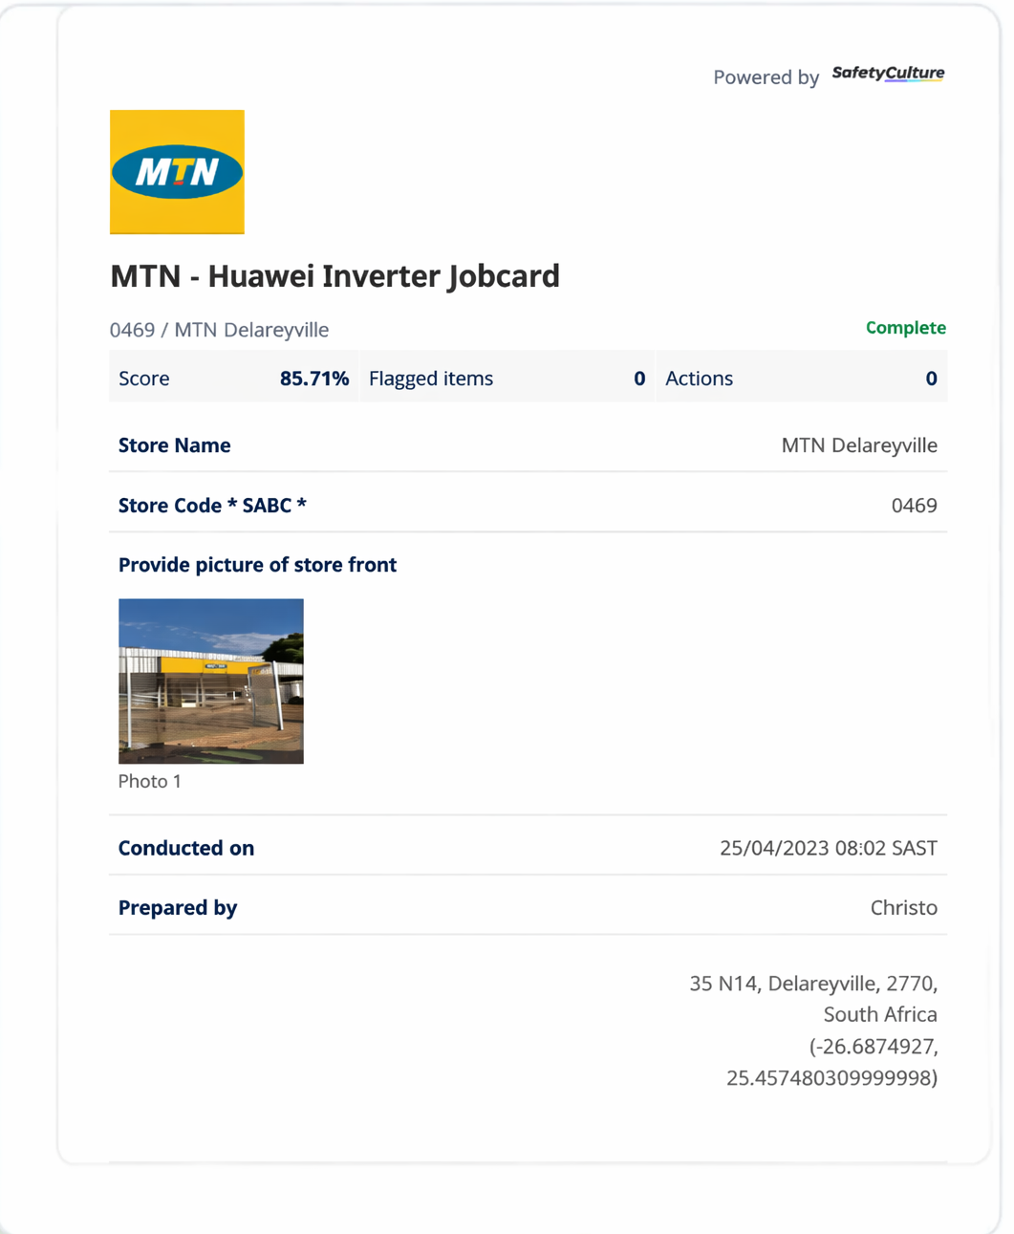

THE PROBLEM
VERTECO
Verteco's Old Job Card Process
A homegrown workflow built on SafetyCulture forms, stitched together manually.
OLD SYSTEM
Captured manually
Technicians fill in details and checklists by hand, job after job.
Photos uploaded one by one
Evidence and signatures are attached individually — slow and error-prone.
Scattered across tools
Data lives across SafetyCulture, spreadsheets, and shared folders.
Records hard to retrieve
Finding a past job card gets harder as job volumes grow.
VERTECO SMARTJOB · TEAM VANTAGE
3

Slide 5



THE SOLUTION
VERTECO
Verteco SmartJob
One connected platform — a web dashboard for managers, a mobile app for technicians — covering every job from creation to signed-off completion.
Web Dashboard
Mobile App
Centralized Records
Digital Sign-Off
Managers create jobs, track status, and run reports in real time.
Technicians complete guided job cards right from the field.
Every job, photo, and signature stored in one searchable system.
Checklists, photo evidence, and e-signatures built into the flow.
VERTECO SMARTJOB · TEAM VANTAGE
4

Slide 6
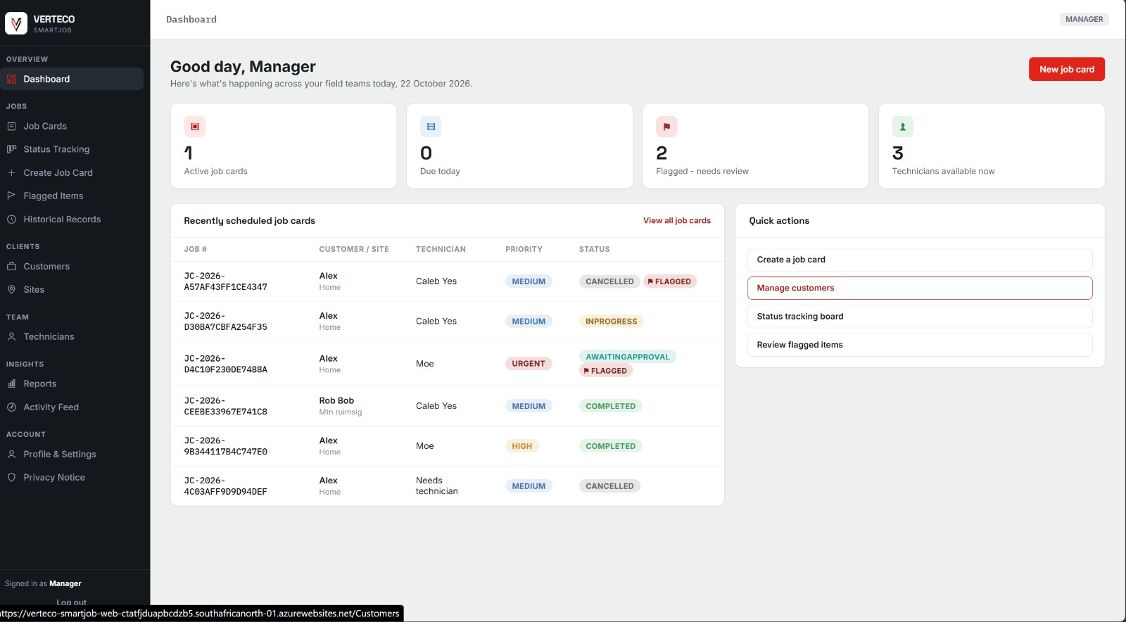
WEB APPLICATION
VERTECO
A Live View for Managers
Track active jobs, flags, and technician availability at a glance.
VERTECO SMARTJOB · TEAM VANTAGE
5

Slide 7
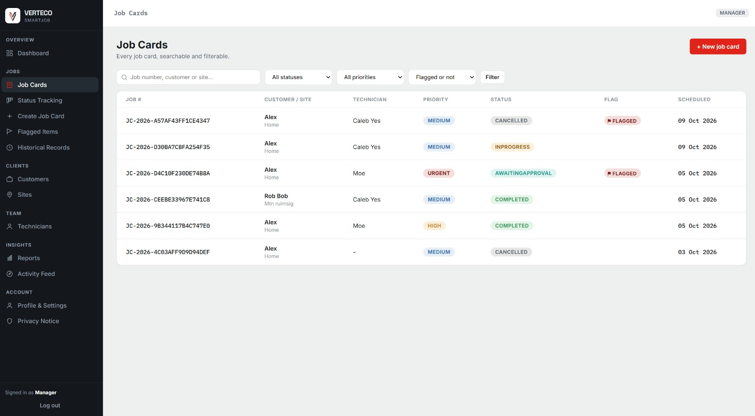
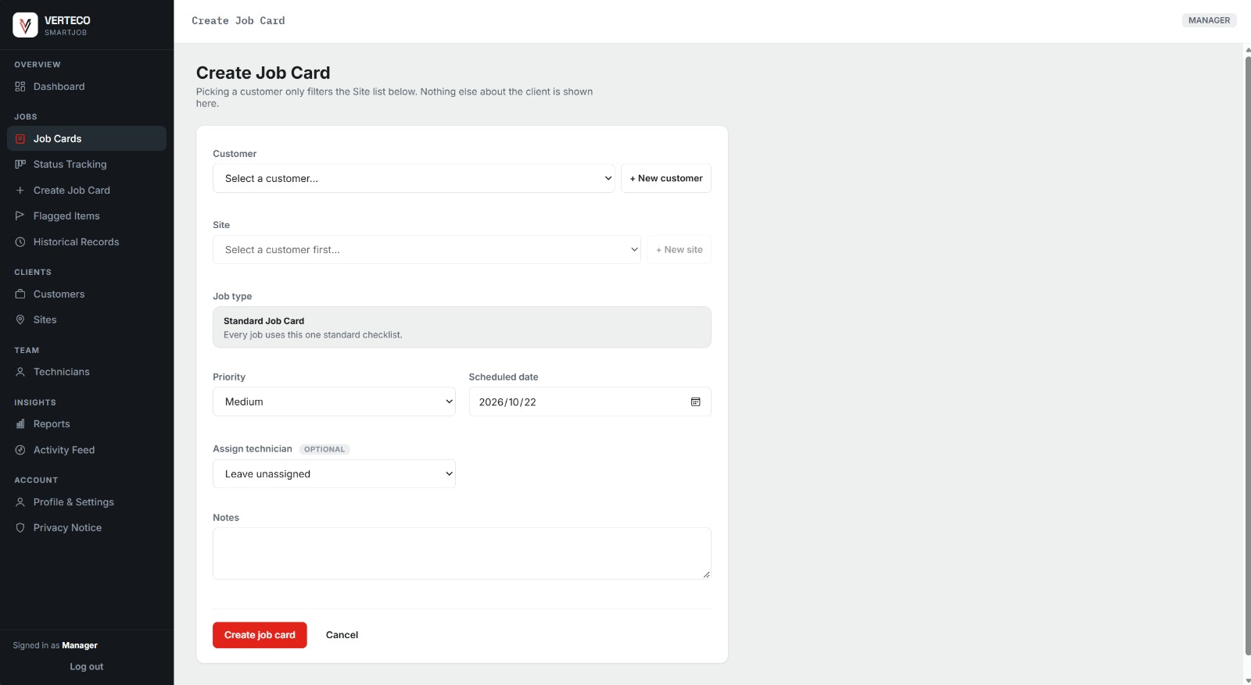
WEB APPLICATION
VERTECO
Create and Track Every Job Card
From a searchable job list to a new job card in seconds.
All job cards in one searchable, filterable list
Create a job card — customer, site, priority, technician
VERTECO SMARTJOB · TEAM VANTAGE
6

Slide 8
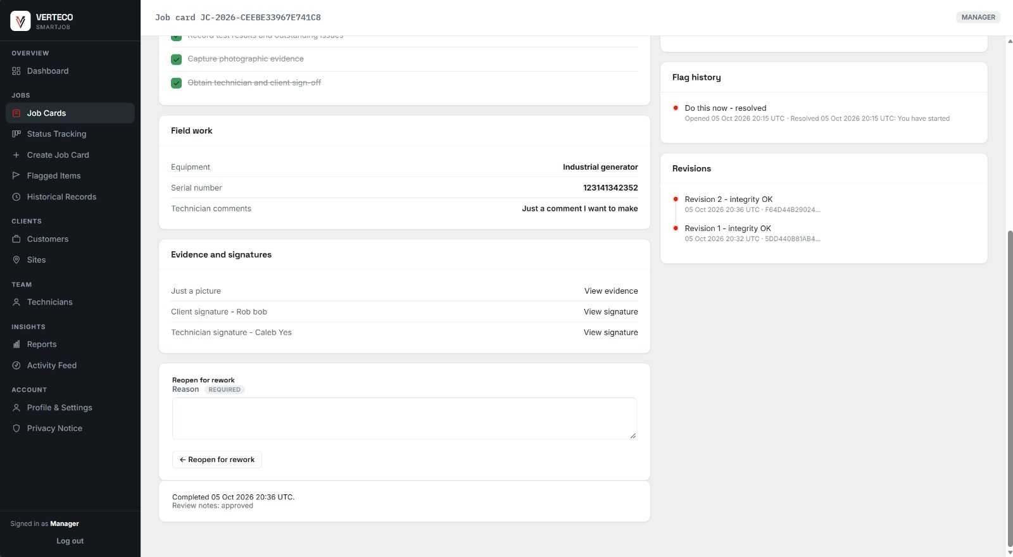
WEB APPLICATION
VERTECO
One Complete, Auditable Job Record
Checklist, field notes, evidence, signatures, and revision history — together.
VERTECO SMARTJOB · TEAM VANTAGE
7

Slide 9
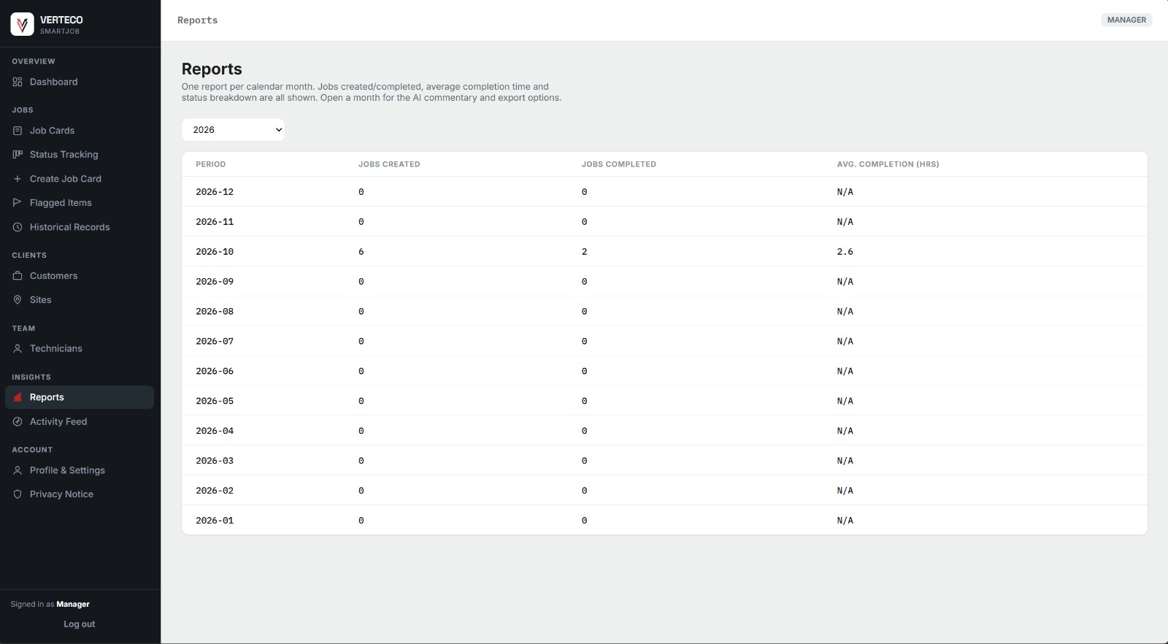
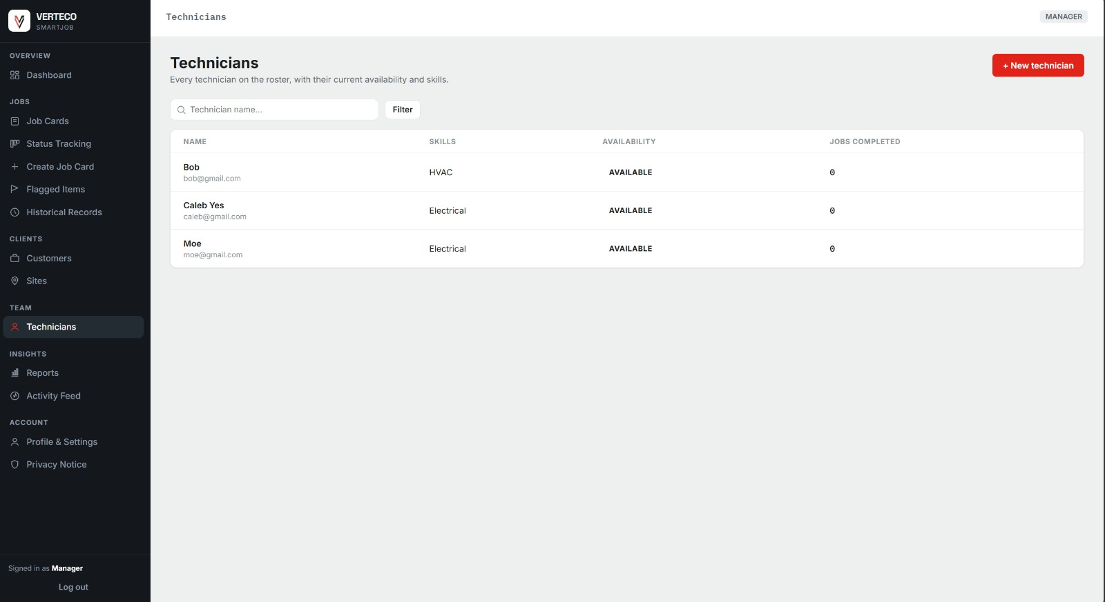
WEB APPLICATION
VERTECO
Reporting and Technician Management
Monthly performance, completion times, and a full technician roster.
Monthly job and completion-time reporting
Manage the technician team and availability
VERTECO SMARTJOB · TEAM VANTAGE
8

Slide 10
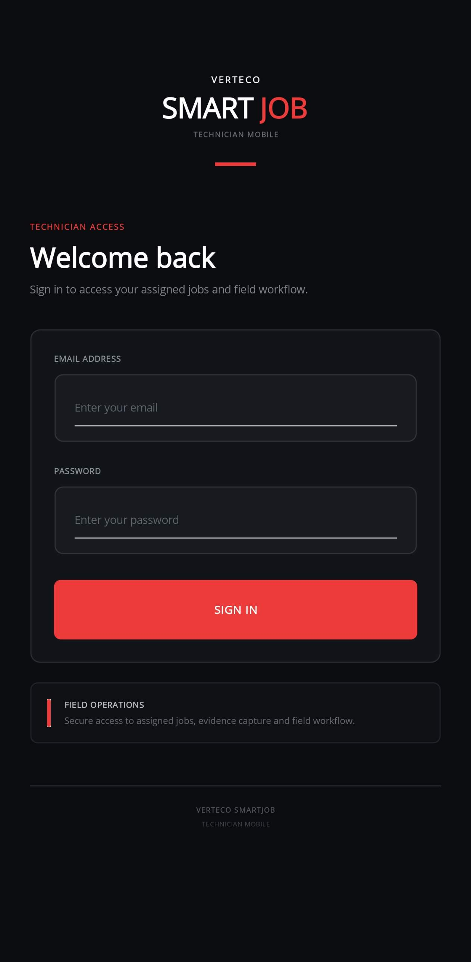
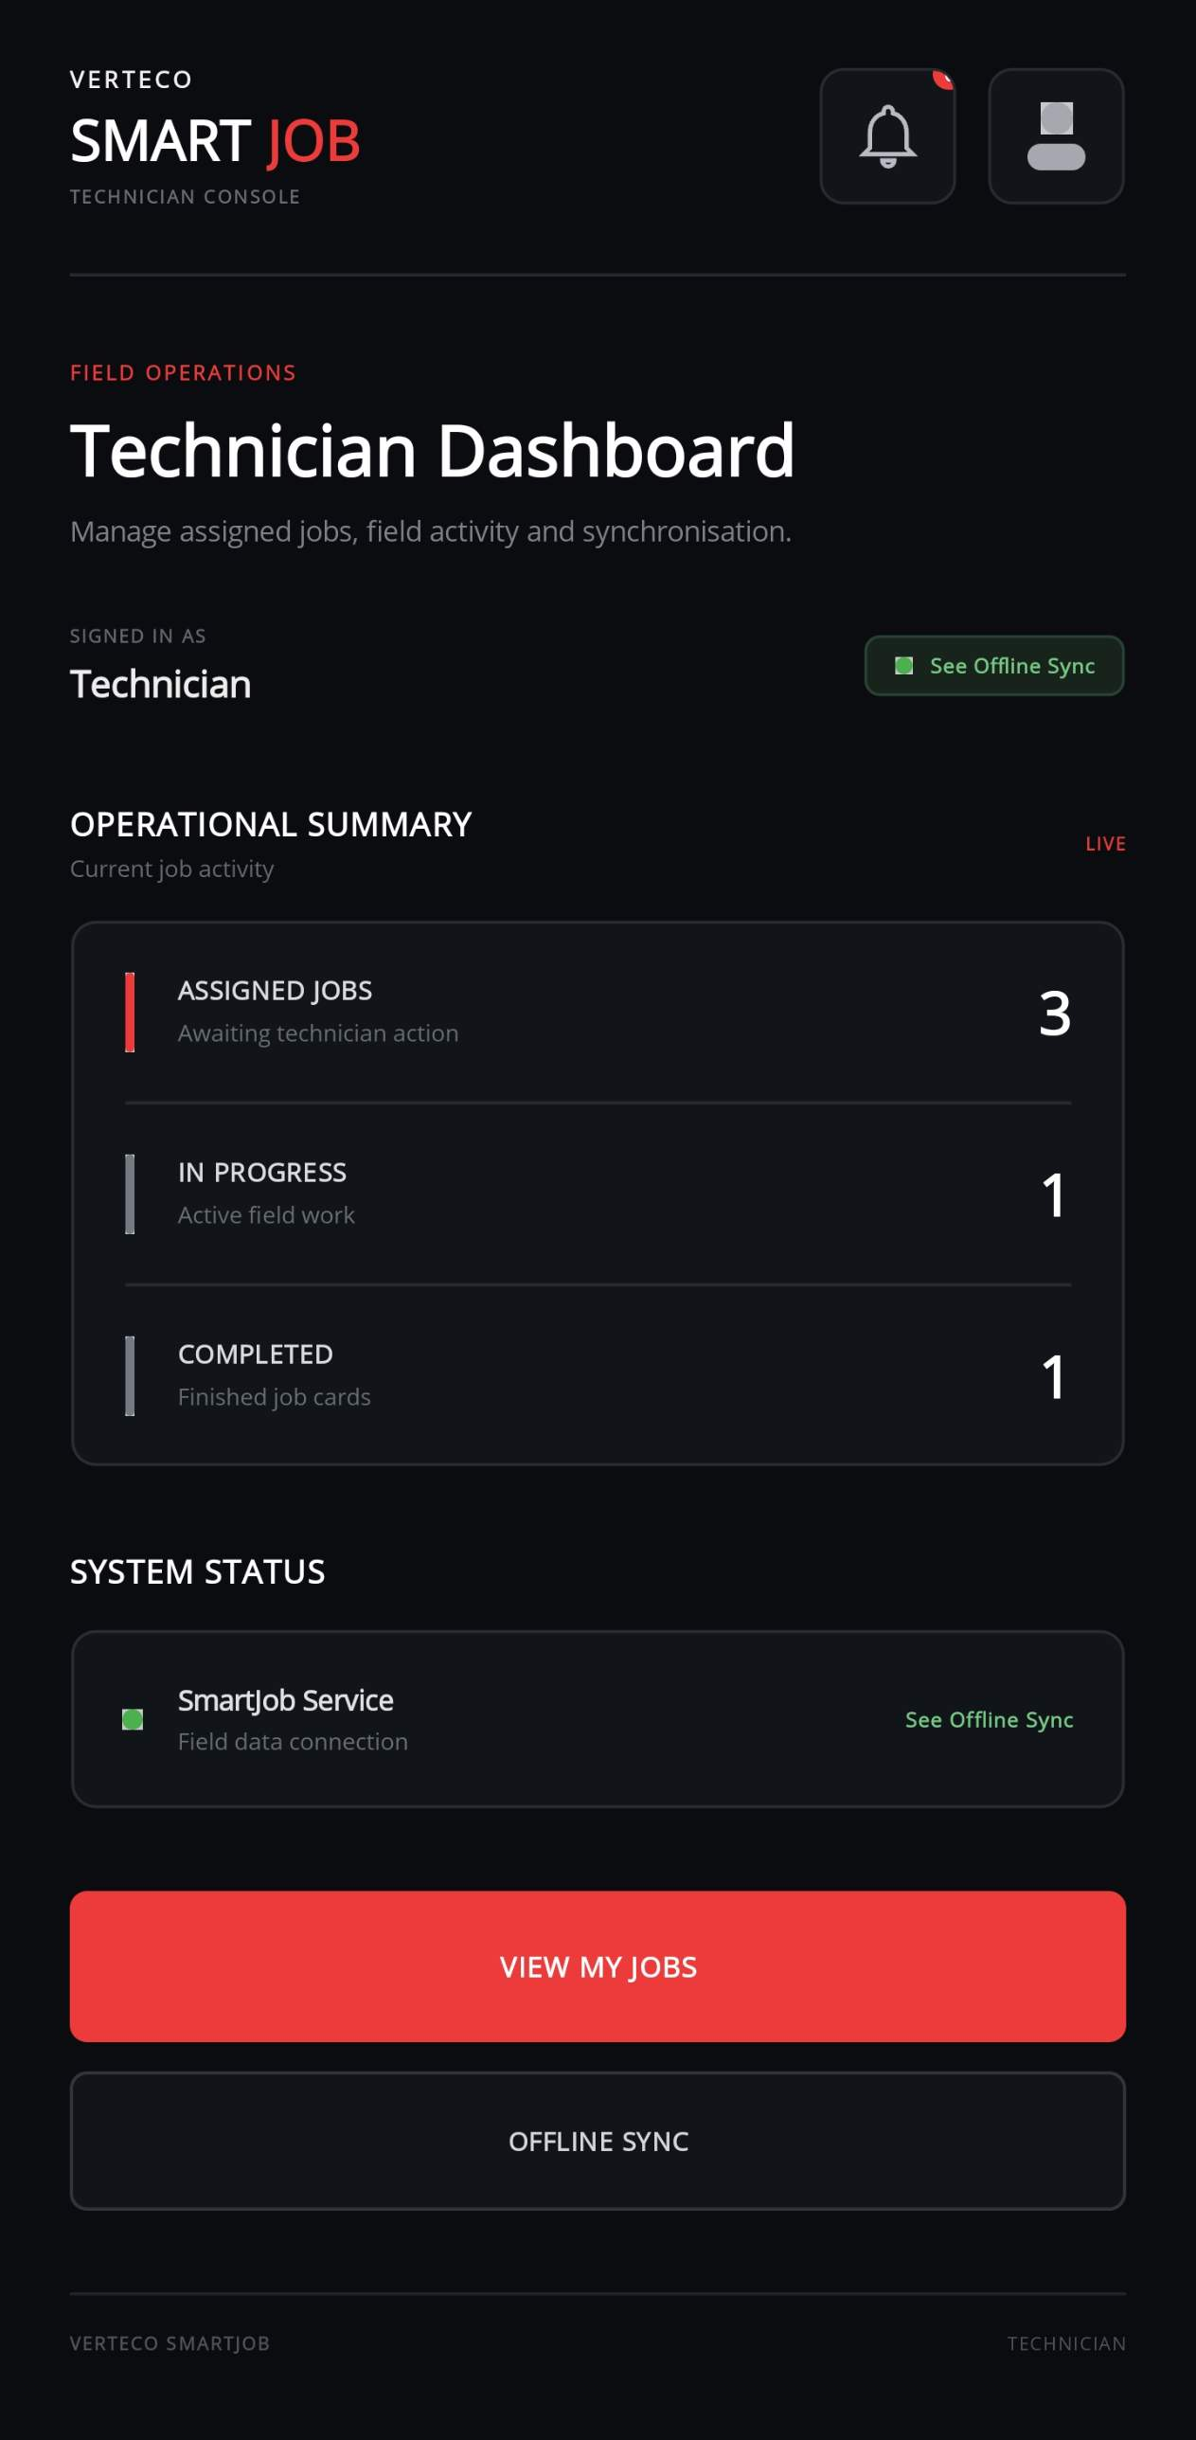
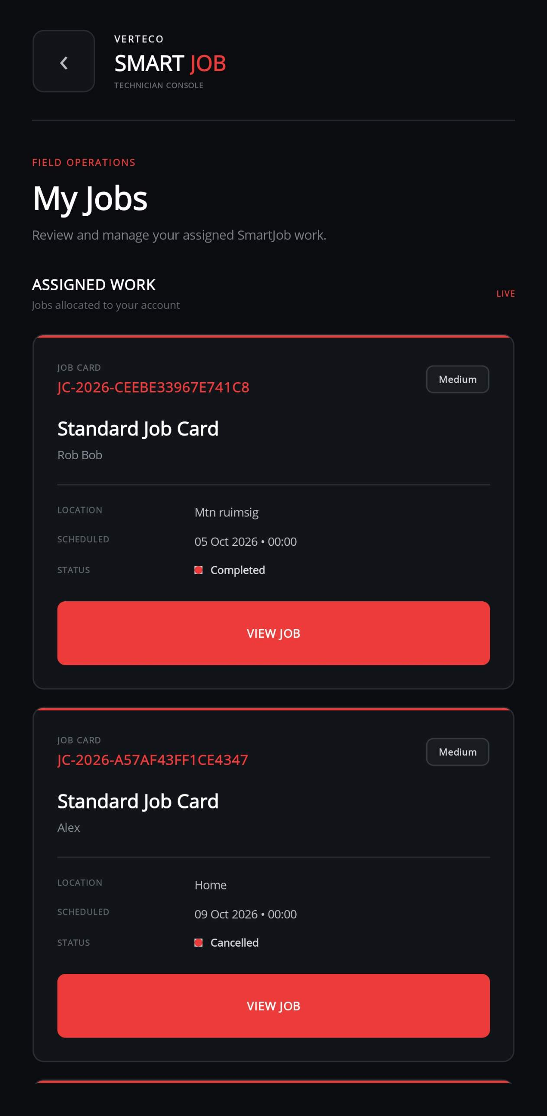
MOBILE APPLICATION
VERTECO
Built for Technicians On-Site
Sign in, see assigned jobs, and open a job card from the field.
Technician sign-in
Daily job summary
My assigned jobs
VERTECO SMARTJOB · TEAM VANTAGE
9

Slide 11
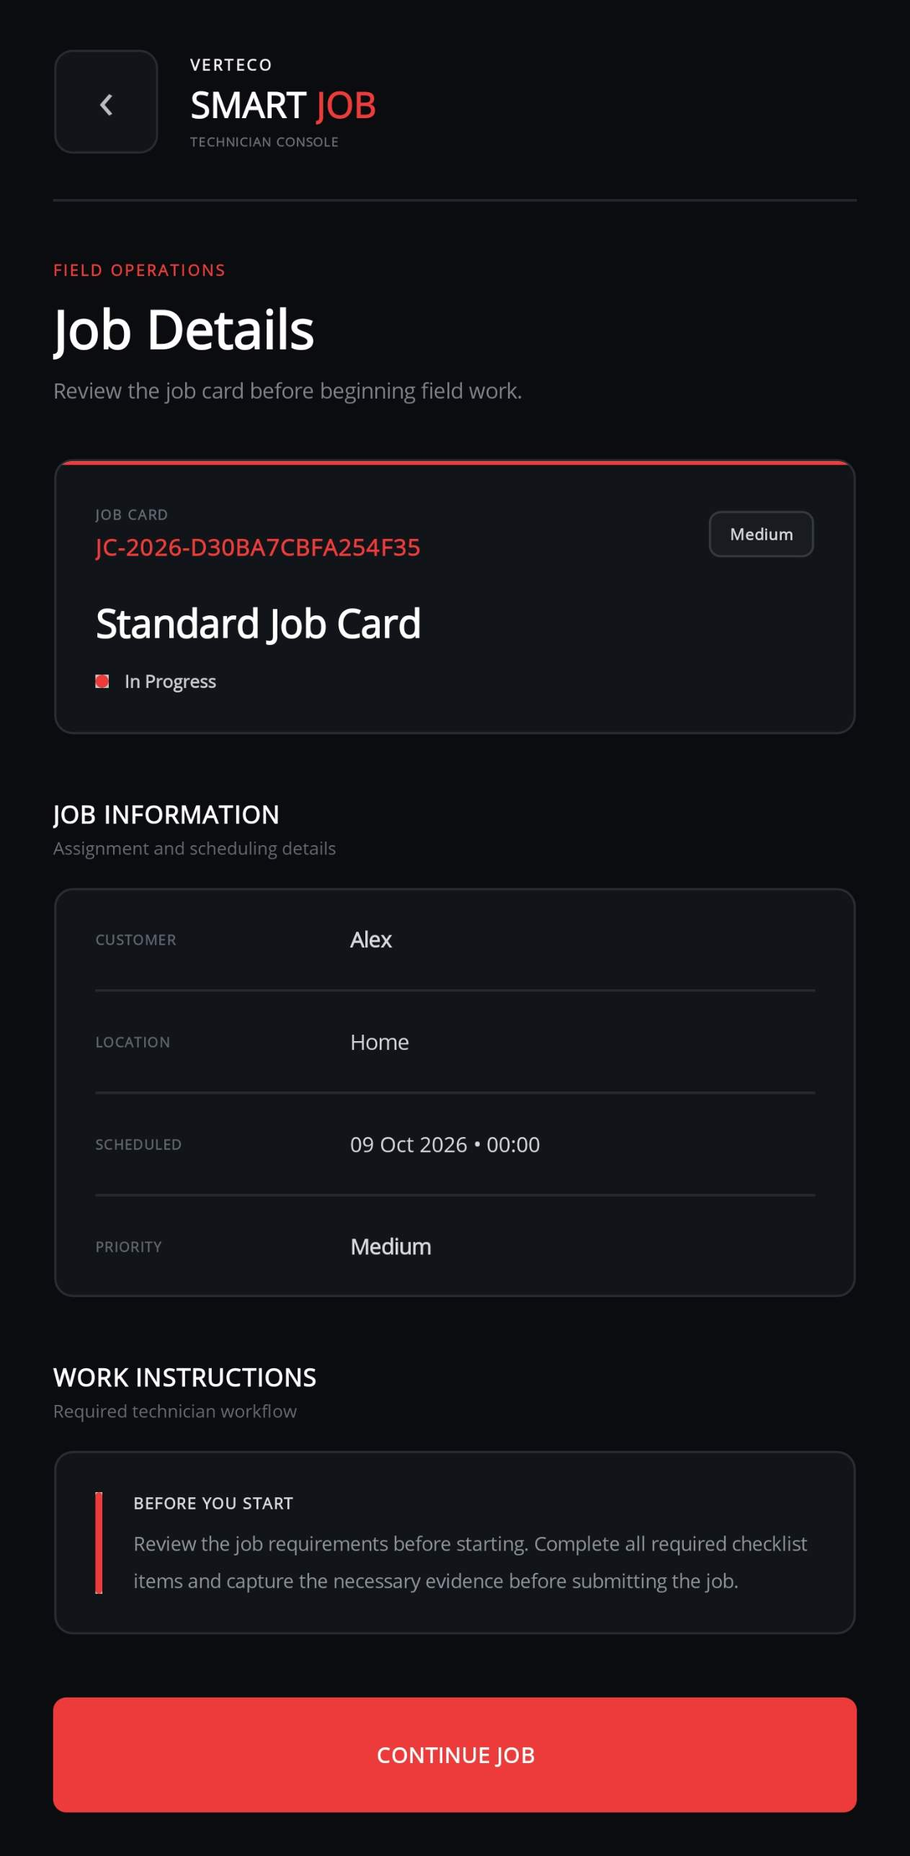
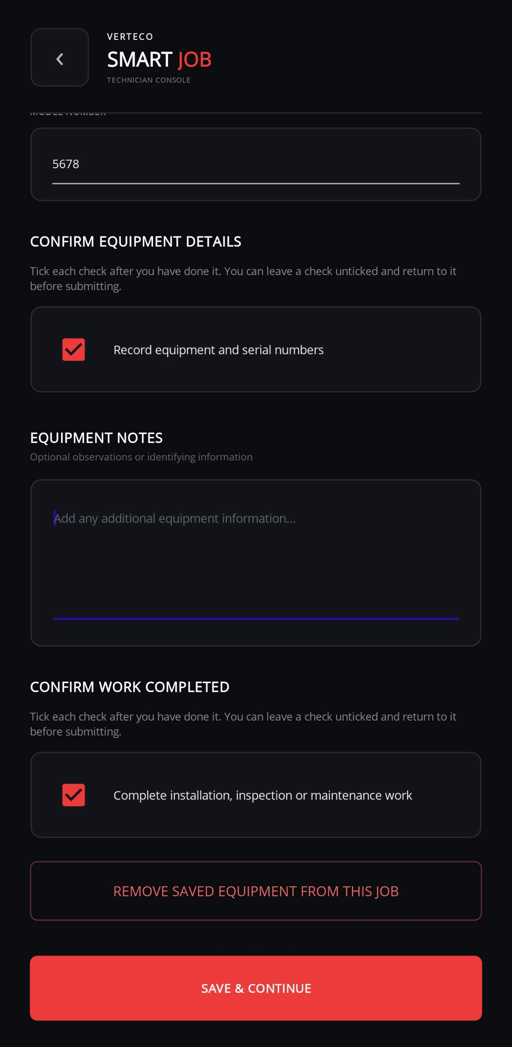
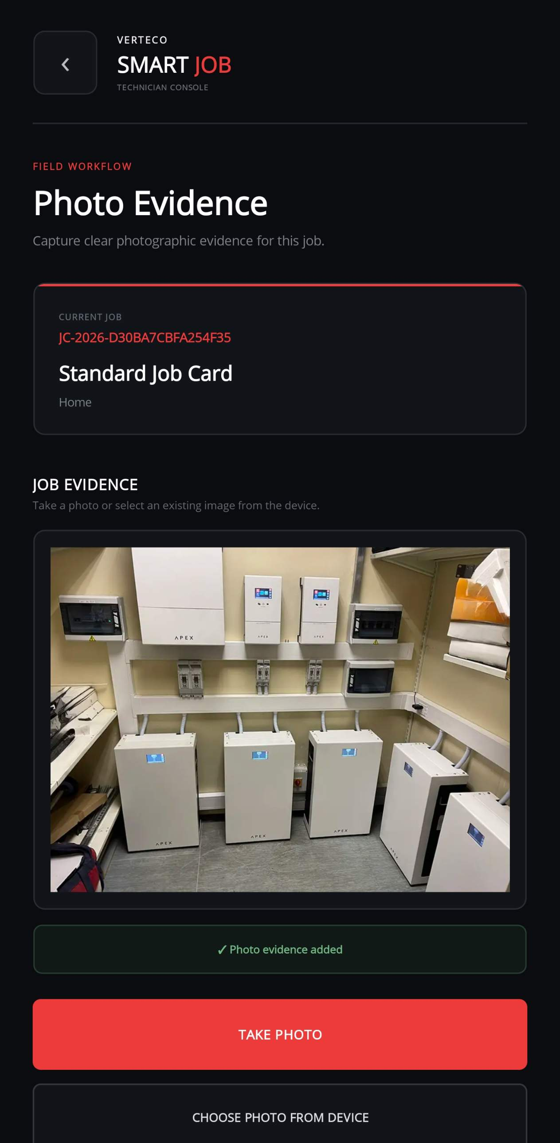
MOBILE APPLICATION
VERTECO
Capturing Every Detail of the Job
Equipment details and photo evidence, captured right where the work happens.
Job details & instructions
Equipment & serial numbers
Photo evidence, in-app
VERTECO SMARTJOB · TEAM VANTAGE
10

Slide 12
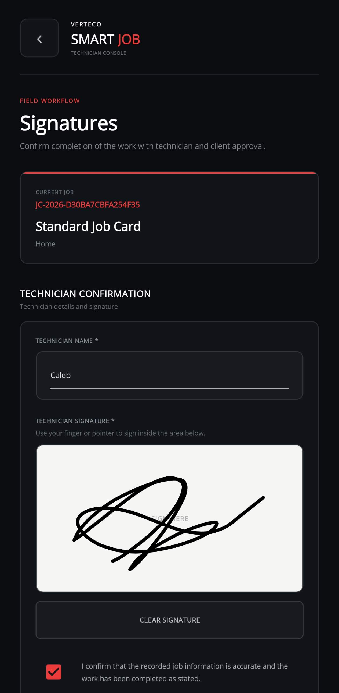
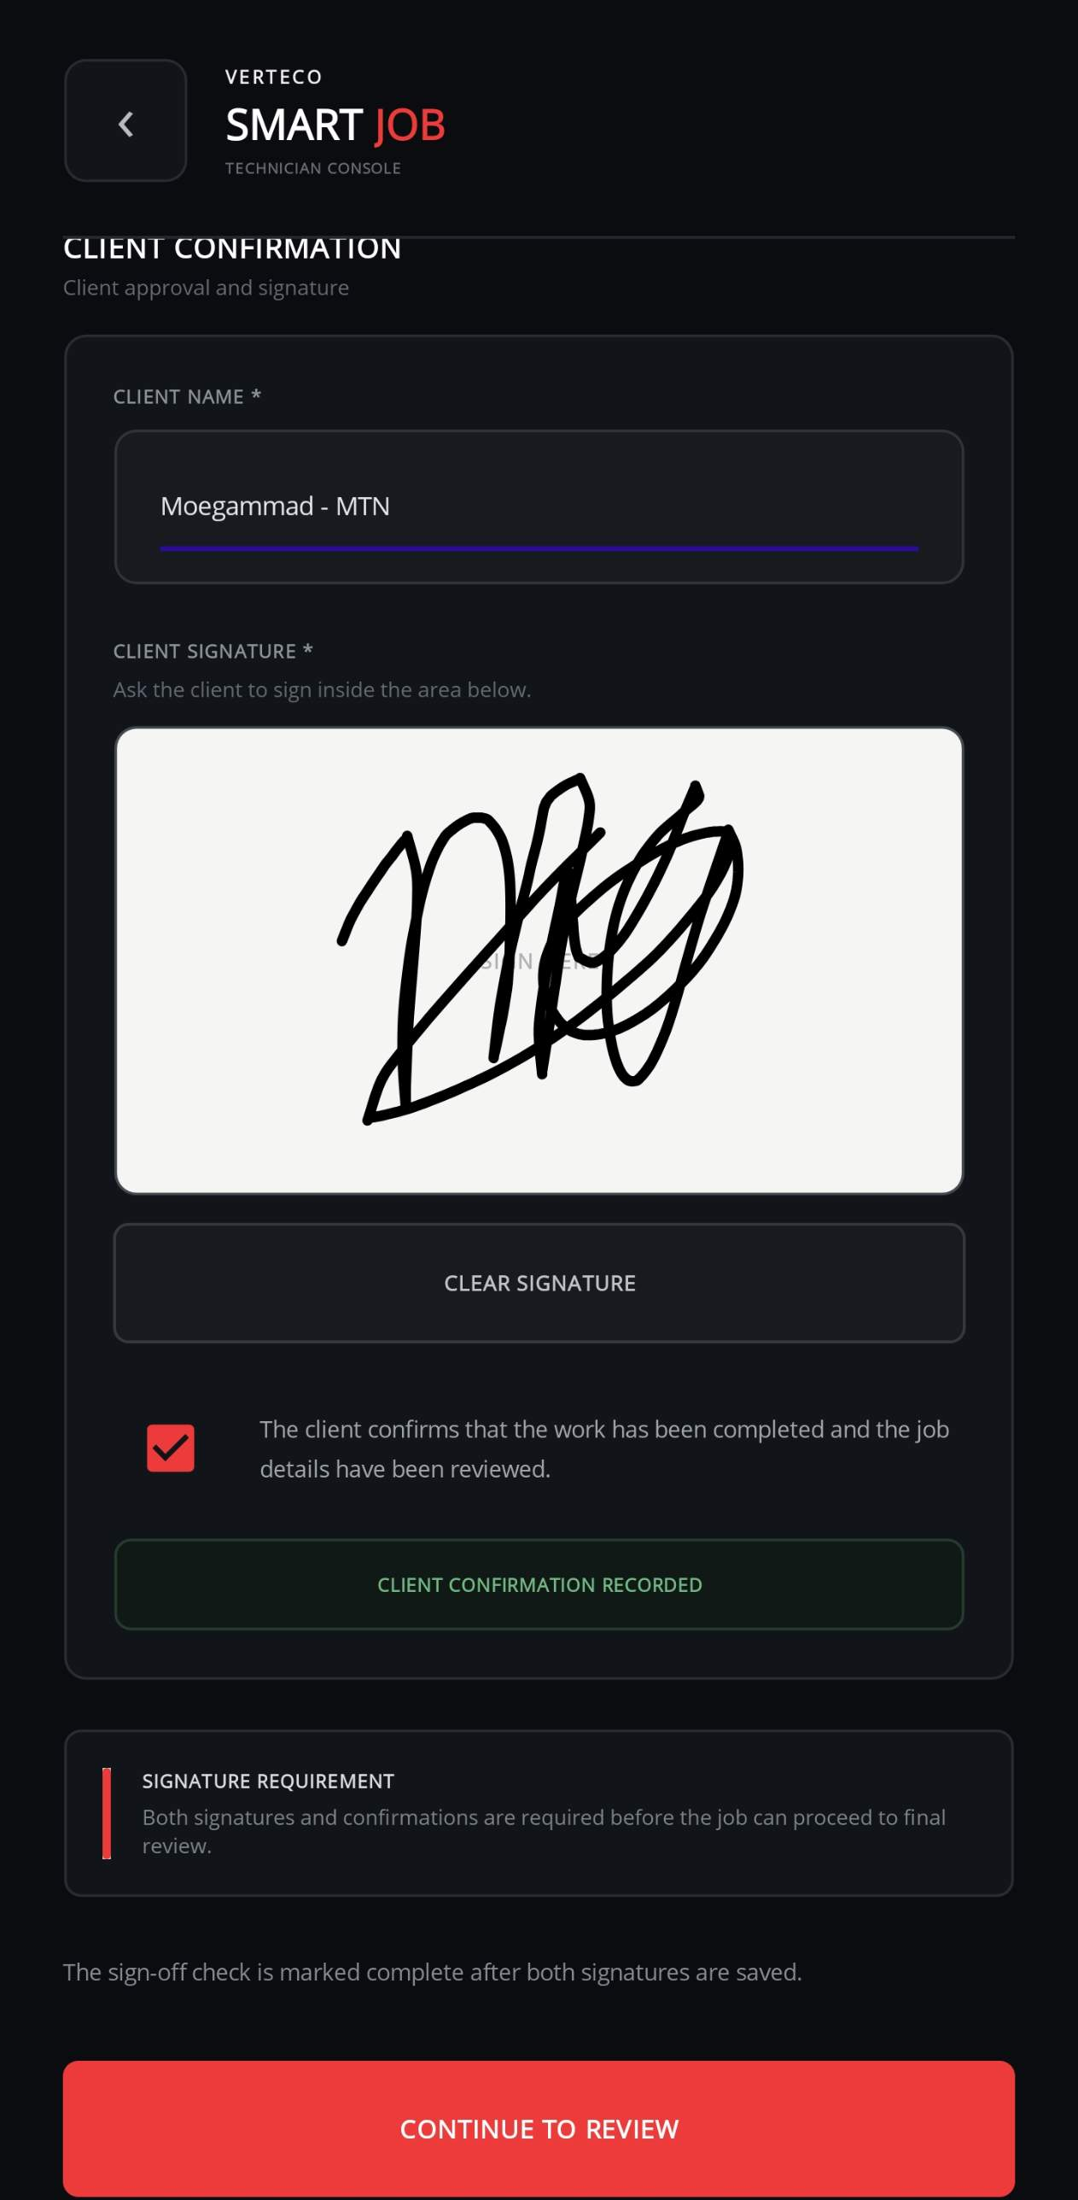
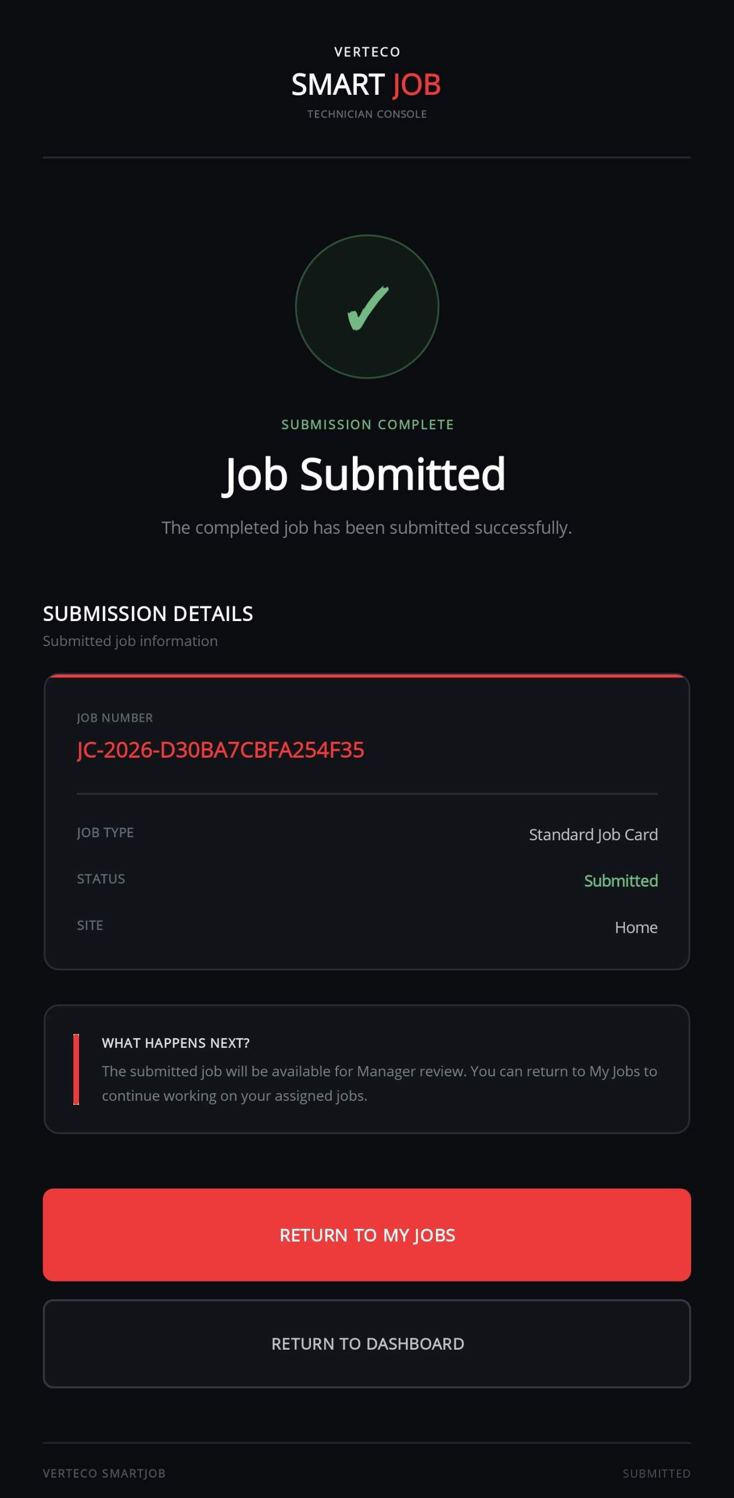
MOBILE APPLICATION
VERTECO
From Signature to Submission
Technician and client sign off digitally, then submit for review.
Technician signature
Client confirmation
Submitted & complete
VERTECO SMARTJOB · TEAM VANTAGE
11

Slide 13


THE IMPACT
VERTECO
From Paper Trail to Digital Workflow
OLD SYSTEM
SMARTJOB
Data capture
Manual, per technician
Guided digital checklist
Photos & evidence
Uploaded one at a time
Captured directly in-app
Signatures
Separate, paper-based
Built-in digital sign-off
Reporting
Compiled by hand
Automated monthly reports
Finding records
Harder as volume grows
Centralized & searchable
VERTECO SMARTJOB · TEAM VANTAGE
12

Slide 14
Thank You
Questions?
Moegammad Alexander
Caleb Forbes
Alexandro Ornelas
Erin Sarjoo
Keeran Perumal
Isaac Phiri
Verteco SmartJob · Team Vantage · Group 20

